Slide 1

“Workout Tracker”
Task - 1

Slide 2

Workout Tracker
This document outlines the Software Requirement Specification (SRS) for the Workout Tracker Application, which assists users in planning and managing workout routines. The application will be built using ReactJS (frontend), HTML, and CSS for the UI, Node.js (backend), and MongoDB (database).
▪
LMS Username
Name
Batch
au311120205008
Andrews A
10
au311120205043
Nitin Jashua V
10
au311120205040
Mukesh K
10
10
au311120205050
Sanjeev Roshan

Slide 3

Taskꢀ-ꢀ1
CreationꢀofꢀSRSꢀ&ꢀGithub
▪
▪
▪
CreateꢀSRSꢀ:ꢀ“YourꢀProject”
Creationꢀ&ꢀSet-upꢀofꢀGithubꢀaccount
Creationꢀ&ꢀHands-onꢀtoꢀvariousꢀcommandsꢀofꢀGitꢀBash
EvaluationꢀMetric:
● 100%ꢀCompletionꢀofꢀtheꢀaboveꢀtasks
Learning Outcome
▪
▪
▪
▪
Getꢀtoꢀknowꢀaboutꢀdifferentꢀlifecycleꢀmodels.
UnderstandingꢀimportanceꢀandꢀhowꢀtoꢀcreateꢀanꢀSRS
KnowingꢀvariousꢀcommandsꢀofꢀGithub
Understandingꢀagileꢀandꢀscrumꢀmanagementꢀtechniquesꢀforꢀefficientꢀproductꢀdevelopment

Slide 4
Step-WiseꢀDescription
Purpose: Provide a comprehensive Software Requirement Specification (SRS) for the Workout Tracker Application.
Functionality: Help users plan, track, and manage their workout routines effectively.
Development Technologies:
Frontend: ReactJS
User Interface: HTML and CSS
Backend: Node.js
Database: MongoDB
Summaryꢀofꢀyourꢀtask
The Workout Tracker App is a robust system developed to aid users in efficiently planning and managing their workout routines. Using ReactJS, HTML, CSS, Node.js, and MongoDB, this application provides a range of functionalities. Users can create, organize, and monitor workout routines, track individual exercises, analyze progress statistics, set personalized fitness goals, and receive timely notifications. It accommodates both regular users seeking fitness improvements and admin users overseeing system performance. Accessible across devices and modern browsers, its frontend communicates seamlessly with the Node.js backend via RESTful APIs, utilizing MongoDB for data storage. Overall, it's a user-centric application designed to empower individuals in achieving their fitness objectives through tailored plans and comprehensive tracking features.

Slide 5
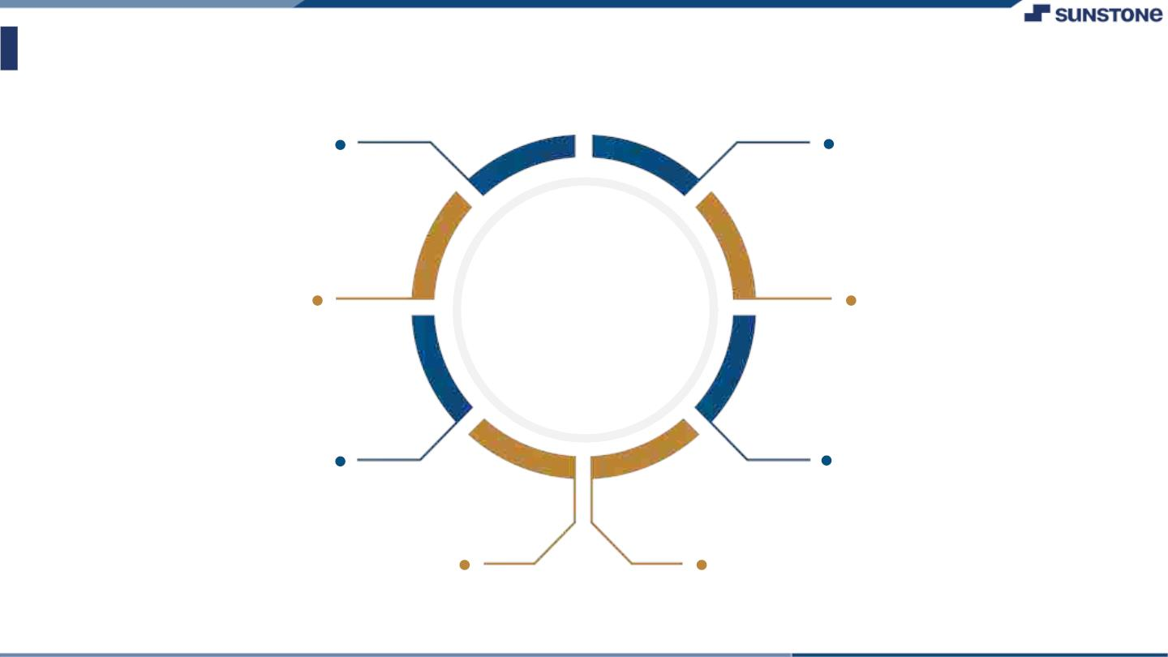
AssessmentꢀParameter
Gatherꢀrequirementsꢀforꢀtheꢀ
project
addꢀReadme.mdꢀfileꢀwithꢀ
descriptionꢀofꢀtheꢀproject
Prepareꢀdatabaseꢀdesignꢀ
schemas
Check-List
Commitꢀallꢀchangesꢀwithꢀ"firstꢀ
commit"
Getꢀyourꢀinitialꢀprojectꢀ
Structureꢀready
createꢀaꢀrepositoryꢀonꢀgithubꢀ
realtedꢀtoꢀproject
Initiateꢀaꢀgitꢀrepository
Pushꢀyourꢀchangesꢀtoꢀgithub

Slide 6

Submission Github
https://github.com/Andrews-A/NM-LICET-IT-GROUP-10

Slide 7


